Slide 1

DATA PROCESSING
WITH SPRING

Slide 2

MICHAEL MINELLA
Lead – Spring Batch &
Spring Cloud Task
JBatch – Committer
Author – The Definitive Guide
to Spring Batch
Speaker - JavaOne Rockstar
Java Champion
Podcast - OffHeap Curmudgeon

Slide 3
@michaelminella
@springbatch
@offheap

Slide 4
AVAILABLE
NOW!
https://www.apress.com/us/book/9781484237236

Slide 5


Slide 6

SCHEDULE FOR
TWO DAYS
Notes:
Calendar Tasks Manager by ✦ Shmidt Sergey ✦ from the Noun Project

Slide 7

YOU’RE STUCK
WITH ME

Slide 8
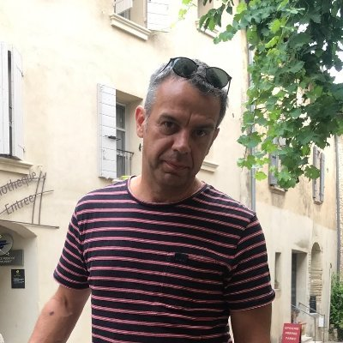
Oleg Zhurakousky
Open source practitioner with over 17 years of experience in software engineering across multiple disciplines including software architecture and design, consulting, business analysis and application development. Speaker who presented seminars at dozens of conferences worldwide (i.e. SpringOne, JavaZone, Hadoop Summit,, JavaOne, Scala Days, Oredev etc.)

Slide 9
Safe Harbor Statement
The following is intended to outline the general direction of VMware's offerings. It is intended for information purposes only and may not be incorporated into any contract. Any information regarding pre-release of VMware offerings, future updates or other planned modifications is subject to ongoing evaluation by VMware and is subject to change. This information is provided without warranty or any kind, express or implied, and is not a commitment to deliver any material, code, or functionality, and should not be relied upon in making purchasing decisions regarding VMware's offerings. These purchasing decisions should only be based on features currently available. The development, release, and timing of any features or functionality described for VMware's offerings in this presentation remain at the sole discretion of Pivotal. Pivotal has no obligation to update forward looking information in this presentation.

Slide 10

WHAT ARE WE GOING
TO TALK ABOUT?

Slide 11

DATA PROCESSING
Notes:
product by monkik from the Noun Project

Slide 12

FOUNDATION OF THE
ENTERPRISE COMPUTING WORLD
Notes:
mainframe by Creative Stall from the Noun Project

Slide 13
“the collection and manipulation of items of
data to produce meaningful information.”
-- Carl French

Slide 14

BASICALLY MEANS
EVERYTHING!
Notes:
world by Pascal Heß from the Noun Project

Slide 15

FOCUS ON INTEGRATION
USE CASES TODAY
Notes:
integration by Gregor Cresnar from the Noun Project

Slide 16

I WANT TO TELL
YOU A STORY

Slide 17

There once was a developer
with a horrible boss…
Notes:
Office Space is copyright 20th Century Fox

Slide 18

CRAZY PROJECTS
RIDICULOUS DEADLINES
Notes:
deadline by Ralf Schmitzer from the Noun Project

Slide 19

COVER SHEETS ON
ALL TPS REPORTS
Notes:
documents by GreenHill from the Noun Project

Slide 20
DEVELOP AN
INGESTION PIPELINE

Slide 21

…Then his “other boss” showed up
with requirements from the Enterprise Architect.

Slide 22
Checklist
1. Microservices
2. Receive Reports via RabbitMQ
3. Store reports in MySql
4. Production Grade Monitoring
5. Run all of this on Kubernetes

Slide 23
ALL DONE BY END
OF THIS TALK?!
Notes:
deadline by Ralf Schmitzer from the Noun Project

Slide 24
HOW?

Slide 25
package io.spring.processor;
import java.util.HashMap;
import java.util.Map;
import java.util.function.Function;
import org.springframework.boot.SpringApplication;
import org.springframework.boot.autoconfigure.SpringBootApplication;
import org.springframework.context.annotation.Bean;
@SpringBootApplication
public class ProcessorApplication {
public static void main(String[] args) {
SpringApplication.run(ProcessorApplication.class, args);
}
@Bean
public Function<String, Map<String, String>> processor() {
return s -> {
Map<String, String> tpsReport = new HashMap<>(2);
tpsReport.put("coversheet", "I've got you covered");
tpsReport.put("report", s);
return tpsReport;
};
}
}
IMPLEMENT
BUSINESS LOGIC

Slide 26
java.util.Function

Slide 27

HOW TO CONNECT FUNCTION
TO RABBITMQ?

Slide 28

SPRING CLOUD STREAM

Slide 29

MESSAGE DRIVEN
MICROSERVICES

Slide 30



Functions serve as the foundation
Spring Cloud Stream
Spring Cloud Function
Spring Boot/Framework

Slide 31
java.util.Supplier

Slide 32
java.util.Function

Slide 33
java.util.Consumer

Slide 34
time
transformer
log

Slide 35
time
transformer
log

Slide 37


Slide 38
Streams

Slide 39


Slide 40

Google Cloud
Pub/Sub

Slide 41


Slide 42


Slide 43


Slide 44
Checklist
1. Microservices
2. Receive Reports via RabbitMQ
3. Store reports in MySql
4. Production Grade Monitoring
5. Run all of this on Kubernetes

Slide 45


Slide 46




SOMETHING SPRING
PROBABLY DOES
Notes:
Puzzle Piece by Wolf Böse from the Noun Project Puzzle Piece by Magicon from the Noun Project Puzzle Piece by Antonio Herrera from the Noun Project Puzzle Piece by Andrew Doane from the Noun Project

Slide 47
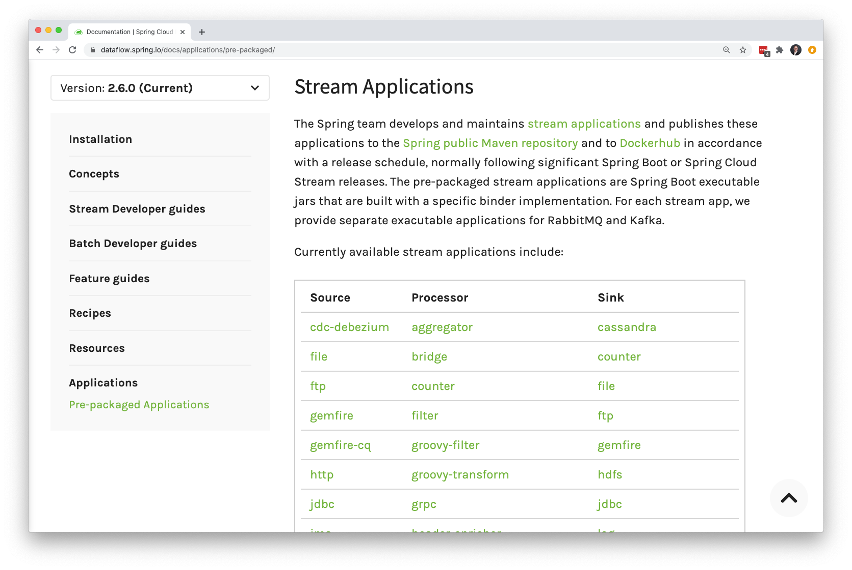
Notes:
66 stream apps available

Slide 48
Driver: org.mariadb.jdbc.Driver
Columns: coversheet,report
Table: TPS_REPORTS
User: root
URL: jdbc:mysql://mysql:3306/mysql
Password: yourpassword

Slide 49
Checklist
1. Microservices
2. Receive Reports via RabbitMQ
3. Store reports in MySql
4. Production Grade Monitoring
5. Run all of this on Kubernetes

Slide 50
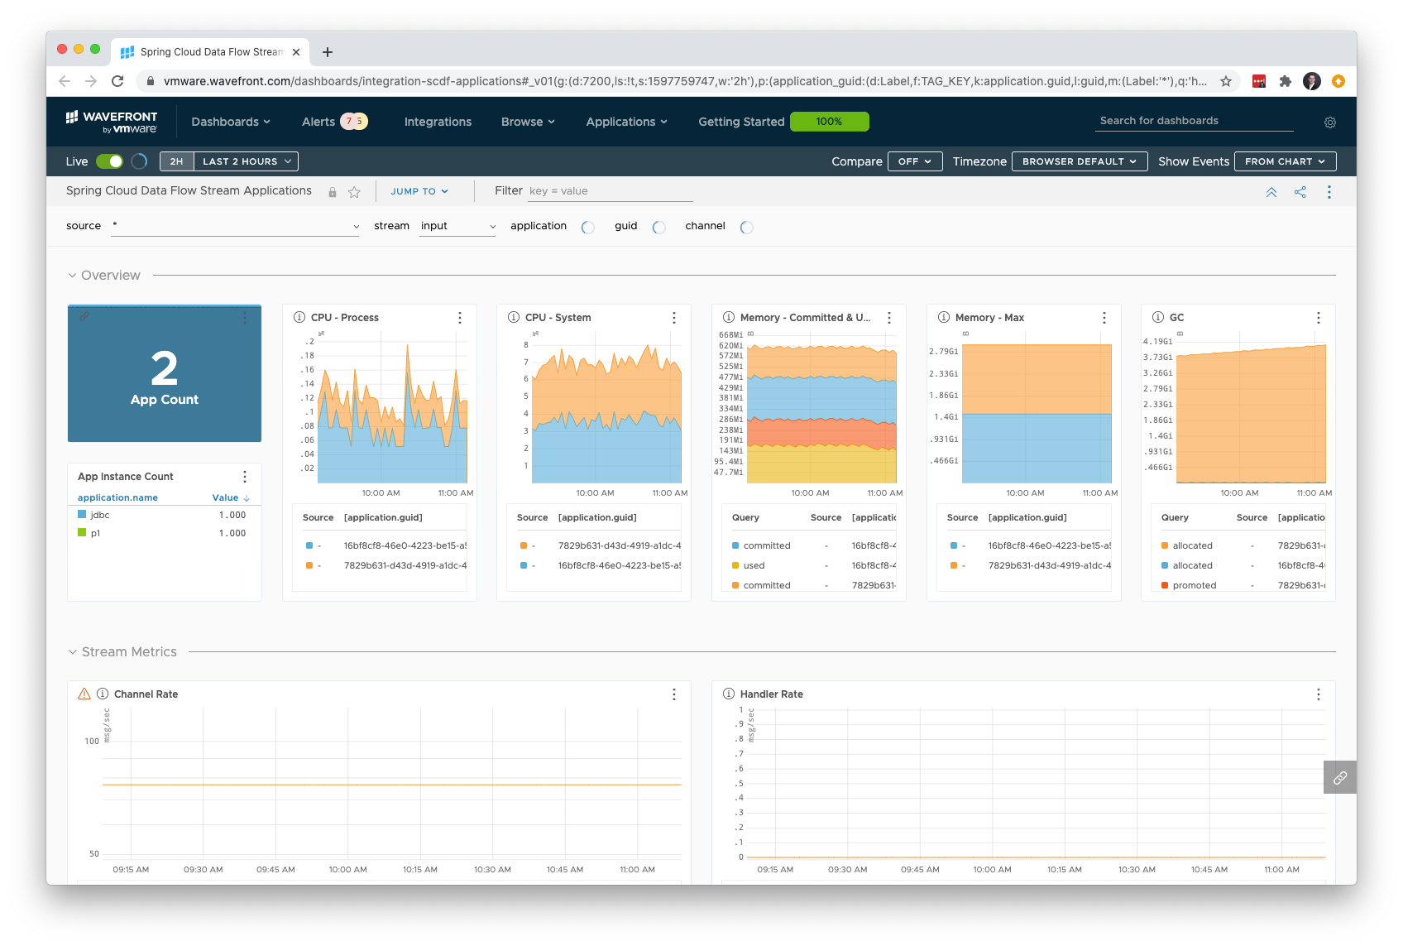
MONITORING
Monitoring

Slide 51

MICROMETER

Slide 52















Slide 53
WHICH BACKEND?

Slide 54
WHICH BACKEND?

Slide 55

EASY BUT
PRODUCTION GRADE
Notes:
work from home by Gan Khoon Lay from the Noun Project

Slide 56
management:
metrics:
export:
wavefront:
enabled: true
api-token: ${wavefront-api-token}
uri: https://wavefront-url
source: scdf-k8s

Slide 57
Checklist
1. Microservices
2. Receive Reports via RabbitMQ
3. Store reports in MySql
4. Production Grade Monitoring
5. Run all of this on Kubernetes

Slide 58

5 MINUTE BREAK
Notes:
break by faisalovers from the Noun Project

Slide 59


Slide 60
RabbitMQ
MySql
Our Processor
Jdbc Sink
A test Source
Replicaset
Service
Deployment
Pod
A LOT
OF YAML
X
=

Slide 61

SPRING CLOUD DATA FLOW

Slide 62

DATA FLOW ORCHESTRATES

Slide 63
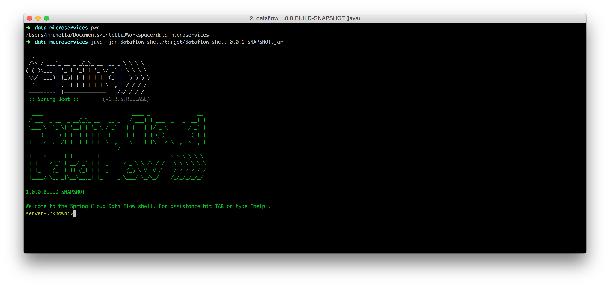

Slide 64
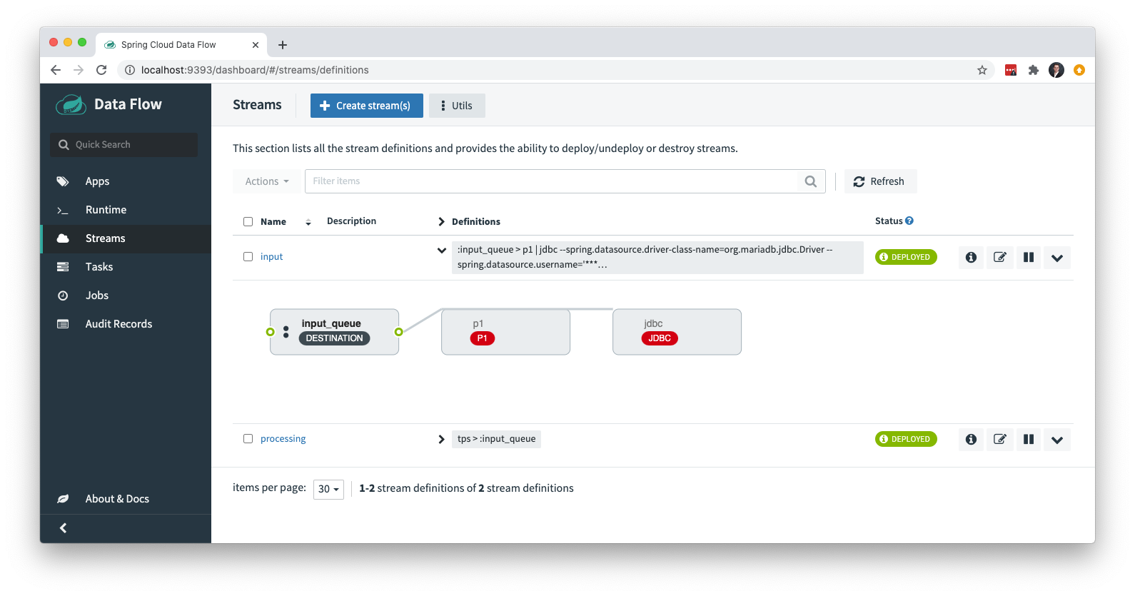

Slide 65

TAKES ADVANTAGE OF
MODERN PLATFORMS

Slide 66


Slide 68
LOCAL*

Slide 69
// DSL
http | filter | hdfs

Slide 70
// DSL
http | filter | hdfs

Slide 71


EVERYTHING IS
SPRING BOOT

Slide 72
A BOOT APP FOR
THE SERVER

Slide 73
A BOOT APP FOR
THE SHELL

Slide 74
ALL BOOT APPS
FOR OTB APPS

Slide 75
app
app
app
Data Flow Server
shell
browser

Slide 76
Checklist
1. Microservices
2. Receive Reports via RabbitMQ
3. Store reports in MySql
4. Production Grade Monitoring
5. Run all of this on Kubernetes

Slide 77

DEMO
Notes:
Theater by Ayub Irawan from the Noun Project

Slide 78

REMEMBER THAT
BAD BOSS?
Notes:
Thinking by Laymik from the Noun Project

Slide 79
He came back…
Notes:
Office Space is copyright 20th Century Fox

Slide 80
FILES OF TPS
REPORTS

Slide 81
…The other boss had more requirements from
the Enterprise Architect as well.

Slide 82
Checklist
1. Spring Batch
2. Minimize Code Duplication
3. Production Grade Monitoring
4. Kubernetes

Slide 83
STILL ALL DONE BY
END OF THIS TALK?!
Notes:
deadline by Ralf Schmitzer from the Noun Project

Slide 84
This is TPS report id 8b46f898-c708-4a51-a566-49d0cc9b37cd.
This is TPS report id f53b30ff-c533-4fa8-8bca-90146fab534a.
This is TPS report id f05142f5-2ebb-4cc1-b256-cbd6dad177a6.
This is TPS report id c8272e4c-4d84-49df-afc3-6978db02efdc.
This is TPS report id 39881186-b320-42ea-8249-e6f83ca6744a.
This is TPS report id 3925f704-2a5f-4e5a-b099-01825bf2e475.
This is TPS report id 60ae448c-e952-477e-bbc5-18b2005bb0e5.
This is TPS report id a1e1ddb9-f024-40cb-a829-8404346f7b60.
This is TPS report id f90d76e2-8f3d-4ca3-96f8-9dd016c95875.
This is TPS report id b3928a96-23be-4361-916e-78ea45e79eaa.
This is TPS report id 93506b48-c7c5-4fc0-a1a7-b395f9e2836c.
This is TPS report id 5bd34b0a-3c21-455c-9770-49ca4df4a8f1.
This is TPS report id ce3adbfd-3867-4d6c-8261-a22d85d62d10.
This is TPS report id 018be6e5-bdad-45bd-97e0-a6a4f5f84433.
This is TPS report id 739cbf31-d511-4d42-9805-0149c16b79fe.
This is TPS report id 62c96a08-fad3-4906-ad49-ef80e4f6641e.
This is TPS report id 58845491-7c49-418a-9b2d-252d6d6c0340.
This is TPS report id 61d66261-a5fa-4928-8057-1743f713259b.
This is TPS report id 66956867-34e9-4965-a468-27ff2cc40c96.
This is TPS report id 9c9470aa-4b88-4df9-8df5-c42da0a196b0.
This is TPS report id 61c49125-7fd2-4c70-9a54-75180f4831cf.
This is TPS report id 7ee06f44-9d4b-434b-9dea-ea74492bc6bc.
This is TPS report id 687d3407-1627-47ca-9a7a-60704f6e94c0.
This is TPS report id 92353d3c-fb2b-4c60-b33d-ae5d428246d6.
This is TPS report id af5f1323-6888-44c8-934f-a2637098e298.
This is TPS report id 73e404dc-c853-4d1d-bf56-74afaa82eb8d.
This is TPS report id e3a9336f-36c6-4c12-b0bd-d92baa8782ba.
This is TPS report id 3fa9784e-1d55-4eab-b879-4f16a1843dc3.
This is TPS report id b843c9f5-9a06-46ce-9b6c-ca9a8561fbdf.
This is TPS report id 8d936362-cbfb-4c29-b6ac-1bbeb7f548df.
FILE FORMAT

Slide 85


Tps Source
Processor
Jdbc Sink
Batch Job

Slide 86
SPRING CLOUD TASK

Slide 87

MICROSERVICES
THAT END

Slide 88
1
TASK REPOSITORY

Slide 89
2
BATCH INTEGRATION

Slide 90
3
STREAM INTEGRATION

Slide 91
@EnableTask

Slide 92

SINGLE STEP
BATCH STARTER

Slide 93

AUTOCONFIGURATION FOR
COMMON USE CASES
Notes:
configuration by Dama Adhikara from the Noun Project

Slide 94
spring:
batch:
job:
jobName: job
stepName: step1
chunkSize: 5
flatfilereader:
name: itemReader
resource: file:/batch-input/input.csv
delimited: true
names: report
strict: false
rabbitamqpitemwriter:
name: itemWriter
cloud:
task:
closecontextEnabled: true
CREATE A JOB ENTIRELY
BY CONFIGURATION

Slide 95

LET’S TAKE A LOOK
Notes:
Binoculars by Gan Khoon Lay from the Noun Project

Slide 96
Checklist
1. Spring Batch
2. Minimize Code Duplication
3. Production Grade Monitoring
4. Kubernetes

Slide 97
DEMO
Notes:
Theater by Ayub Irawan from the Noun Project

Slide 98

LOOKING AHEAD

Slide 99


Slide 100
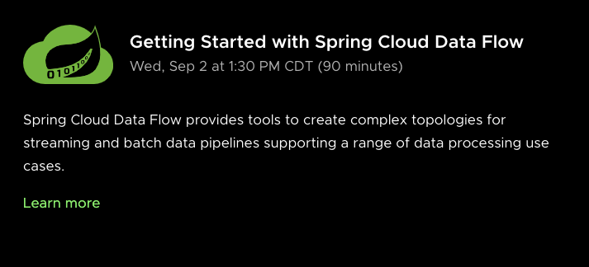
SCDF workshop

Slide 101
- Batching for the Modern Enterprise – Michael Minella
- Walk through Spring Cloud Data Flow
– Ilayaperumal Gopinathan & Glenn Renfro
- What’s new in Spring Batch - Mahmoud Ben Hassine
- Game of Streams: How to tame and Get the most from your
messaging platforms – Mark Heckler
- Functions – Implement once, execute anywhere – Oleg Zhurakousky
- Connect your functions with Rsocket – Oleg Zhurakousky and
Spencer Gibb

Slide 102
TOMORROW
Notes:
Calendar Tasks Manager by ✦ Shmidt Sergey ✦ from the Noun Project

Slide 103

THANKS!
Notes:
wave by HeadsOfBirds from the Noun Project

Slide 104





Slide 105





